Slide 1

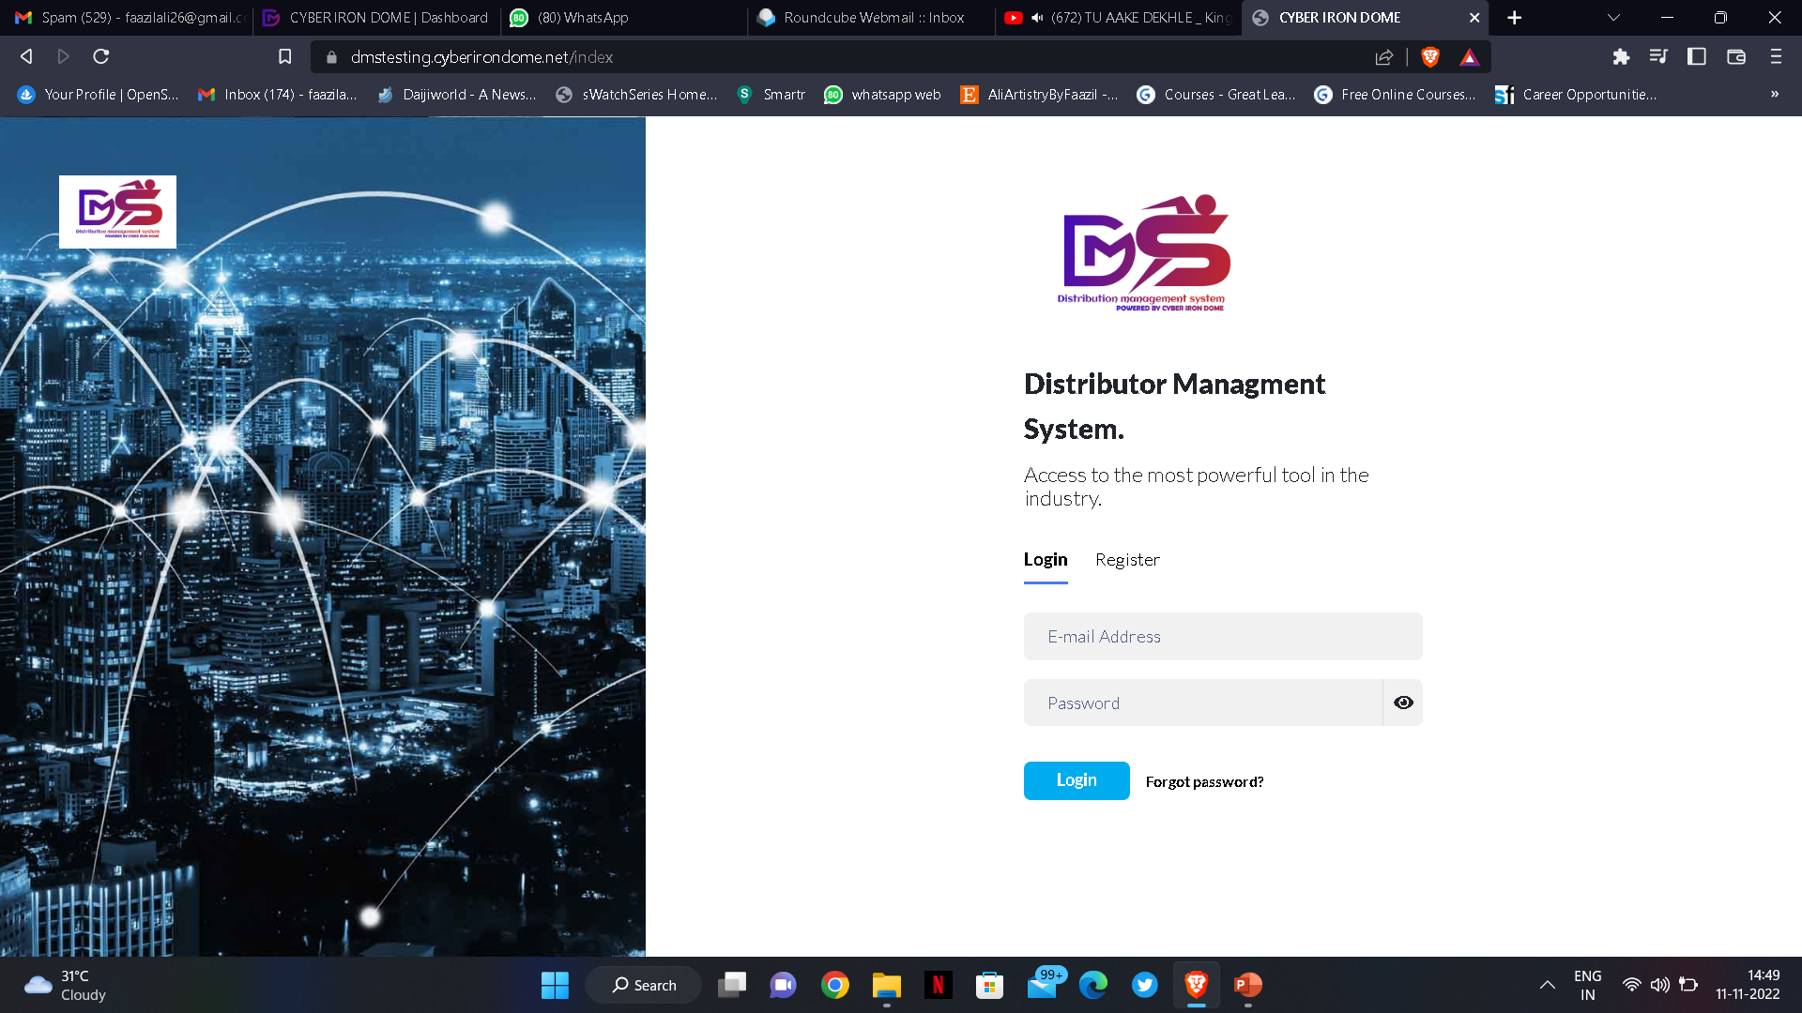
Distributor Management System
Powered by Cyber Iron Dome ​​
Admin help Manual

Slide 2


DMS
Distributor management system is a simple user friendly application created by Matayo that keeps the track records of all the resellers, vendors, partners and clients.
DMS captures and stores all the characteristics data from time to time.
Page 2 of 20

Slide 3
Benefits of DMS and where it can be used?
DMS will provide higher level view for admin / super admin and resellers.
Here CID will act as super admin and NeuShield as admin and even all re-sellers has the authority to keep track records of there prospects/clients.
It is a complete one stop Data Management tool which will help all the resellers , admin and super admin to overview the progress of each and every stage.
Page 3 of 20

Slide 4
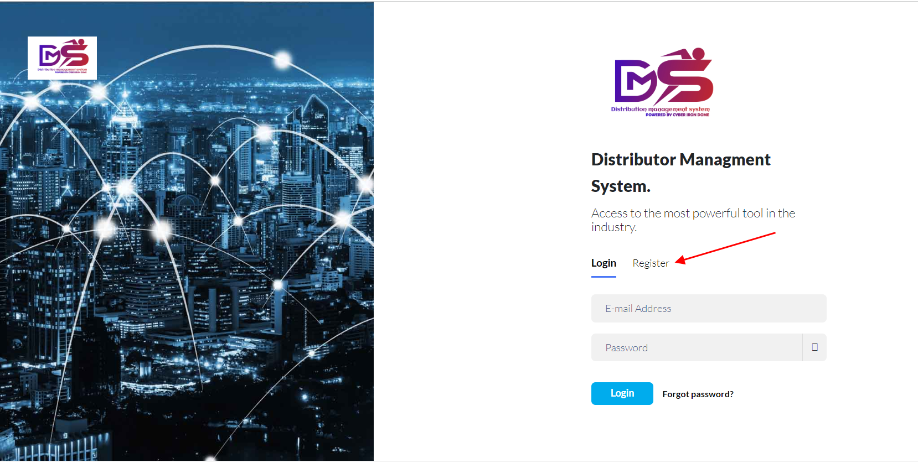

How to Login as Admin in DMS?
Login into dms.cyberirondome.com as Admin.
Page 4 of 20

Slide 5
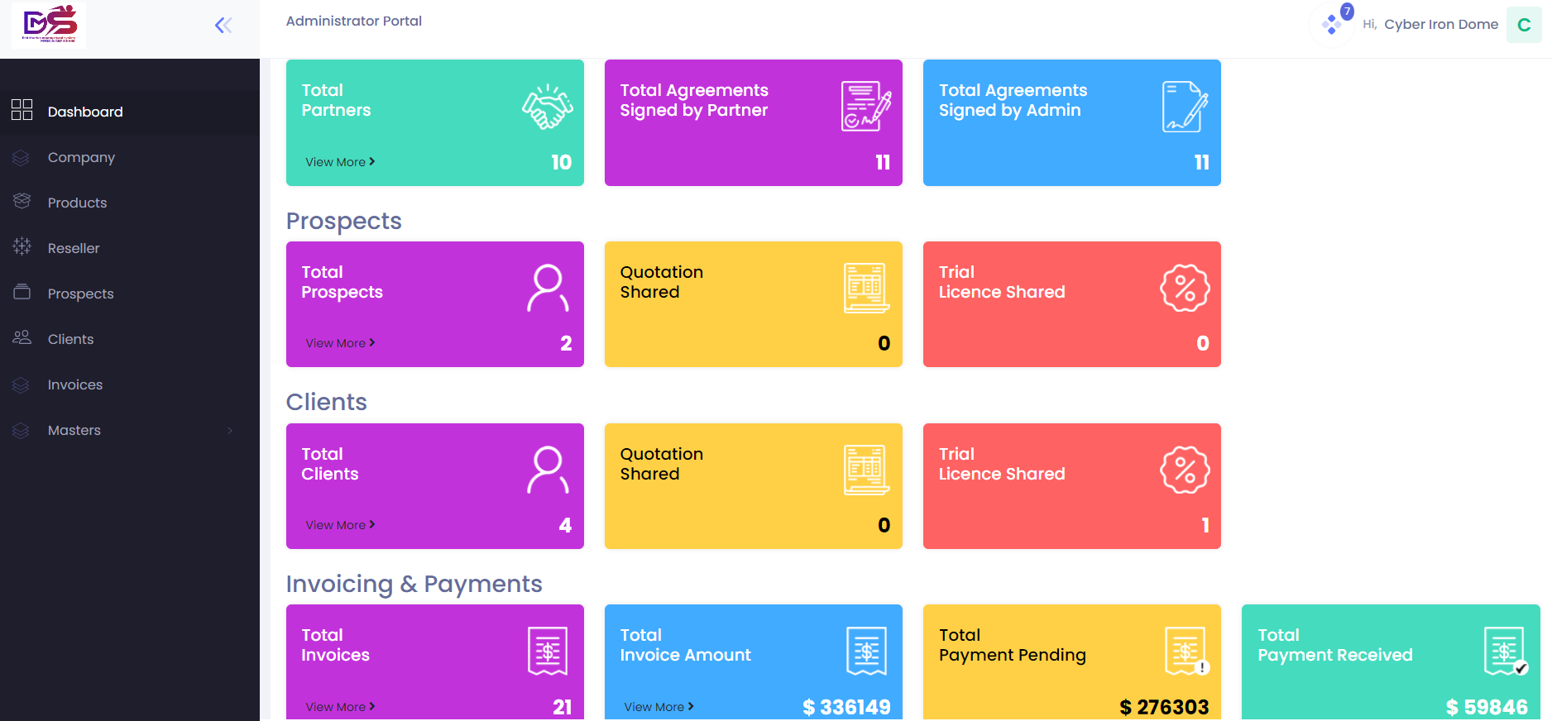

Admin Portal in DMS
The Dashboard of the Admin Portal where all the details are captured to view.
Page 5 of 20

Slide 6
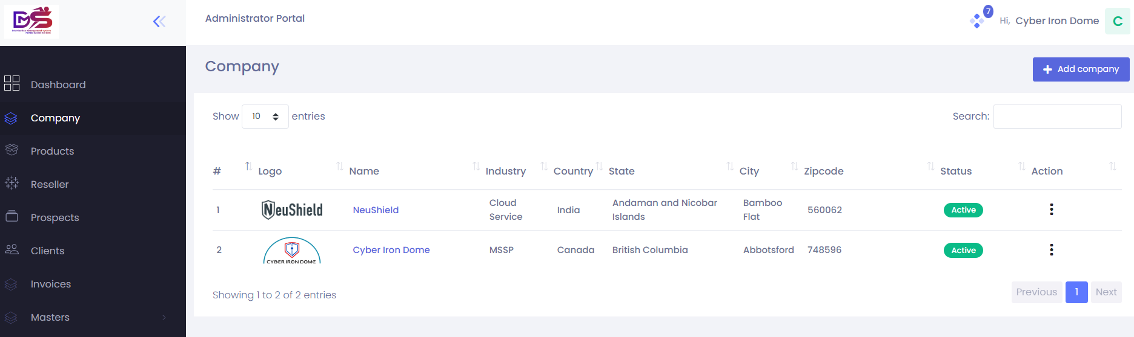
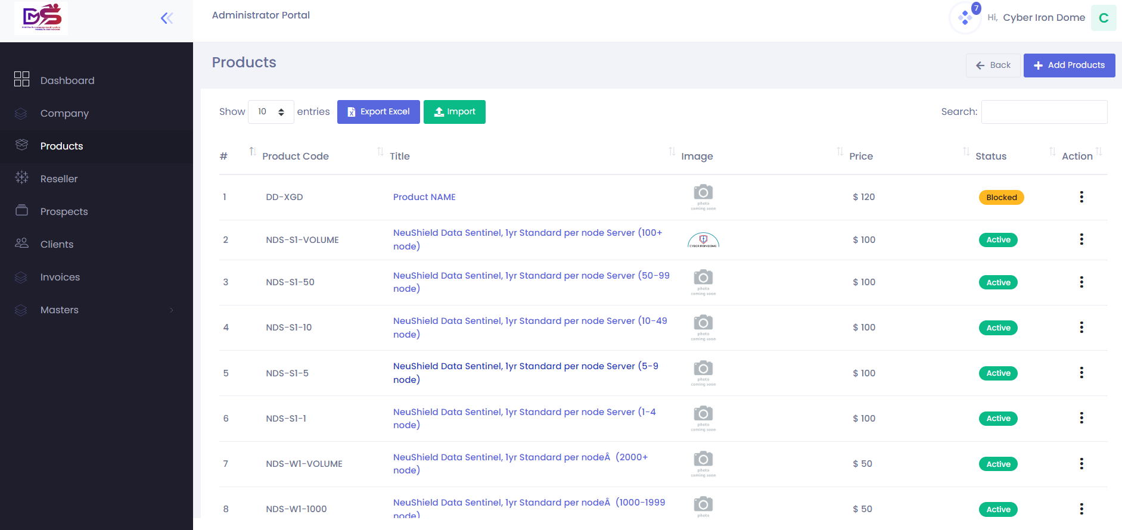

Admin Portal in DMS
The Company details mentioned below, using Add Company option Admin can Modify the details.
The Product details mentioned below, using Add Product option Admin can Add or Delete and products.
Page 6 of 20

Slide 7
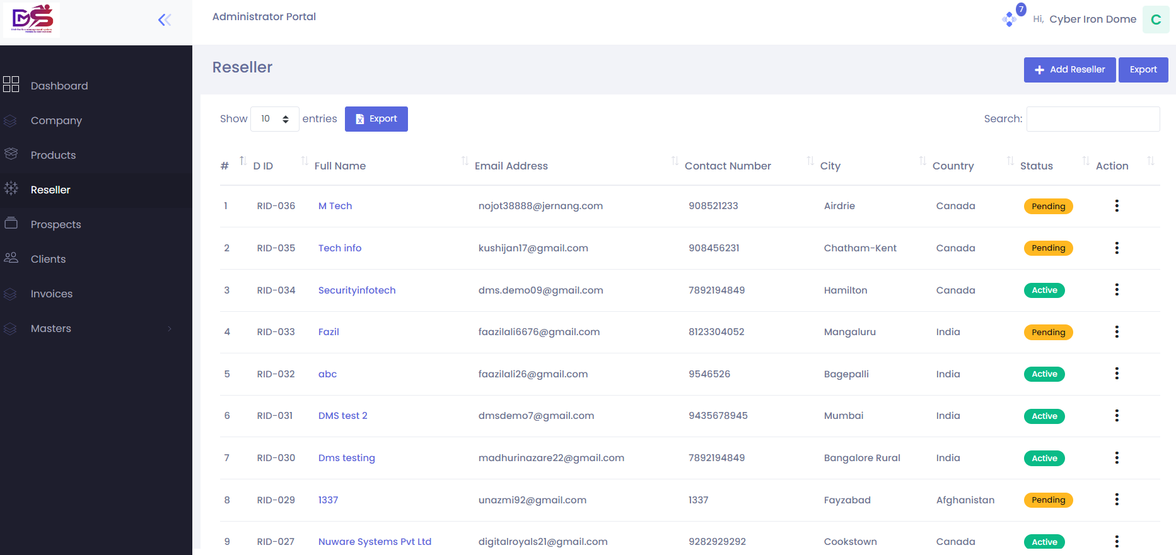
Admin Portal in DMS
All the Resellers details mentioned here who will Register themselves successfully into DMS application.
Page 7 of 20

Slide 8
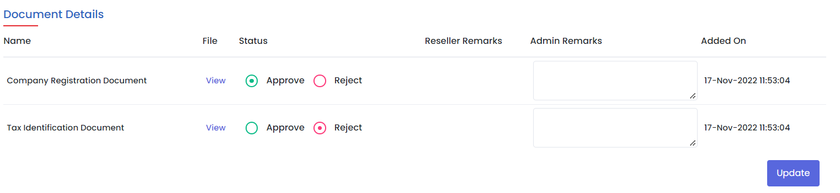
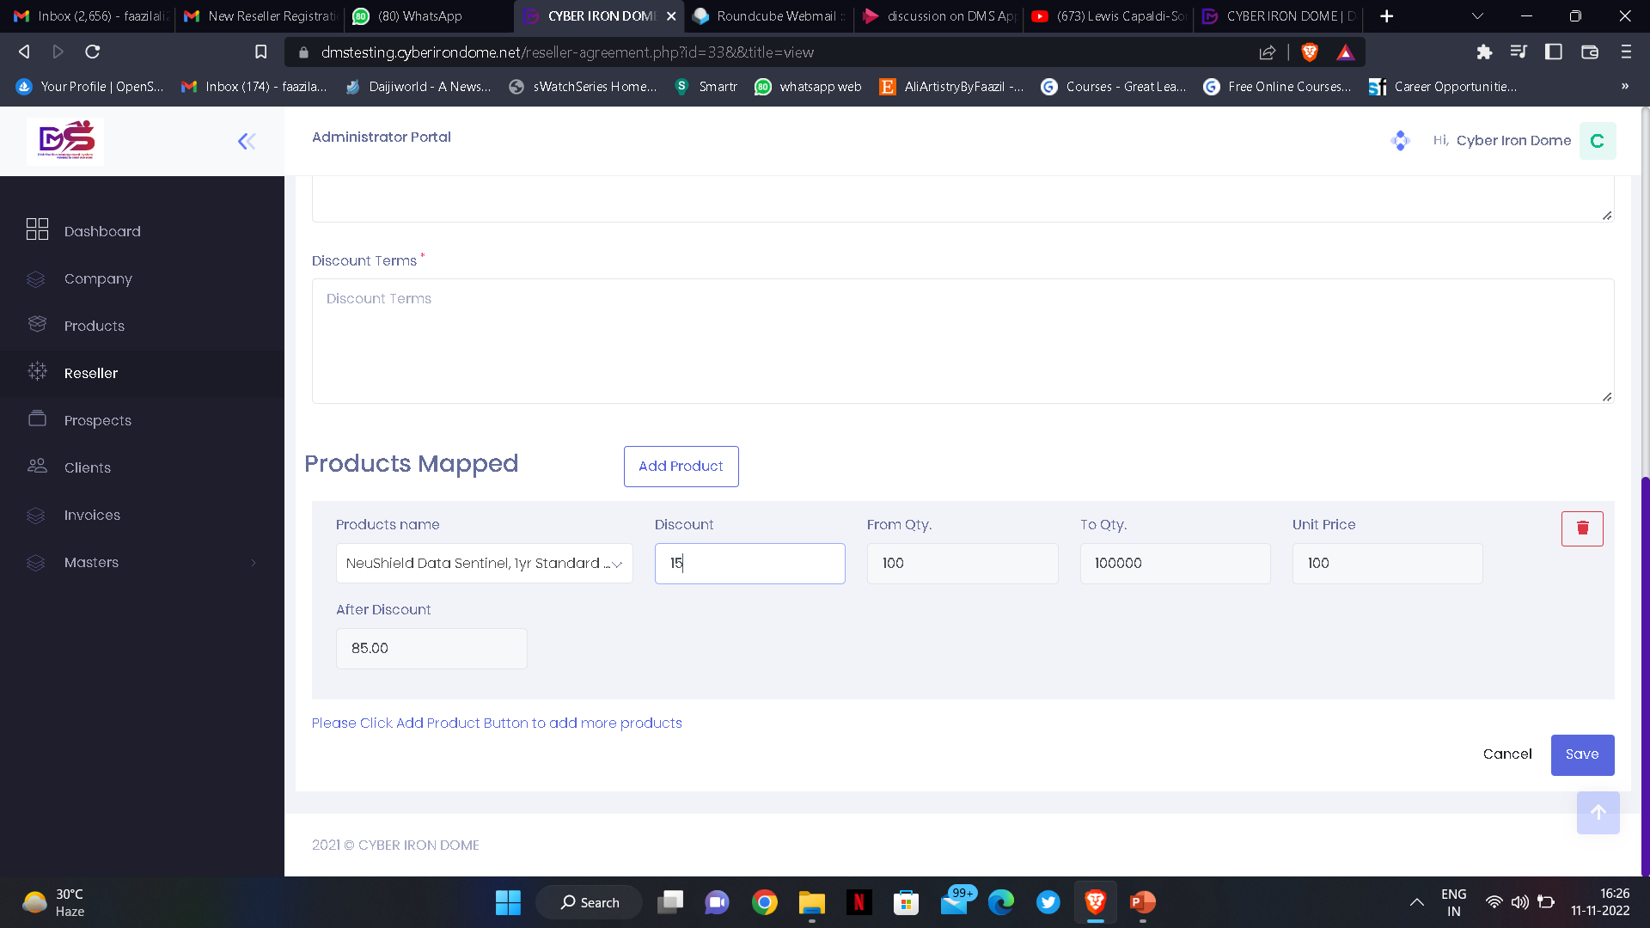

For registration of Reseller Company registration document & Tax Identification document are the 2 important documents that is asked to be submitted by the partner / re-seller for compulsory authentication.
which will be reviewed and Approved /Rejected accordingly by the Admin and reseller will receive the mail for the same.
Once the agreements are approved, the admin will add :
Contract Period
Add Products
Add Discount Terms
Add additional Terms & Conditions.
using the save button option he will save the details.
Page 8 of 20

Slide 9
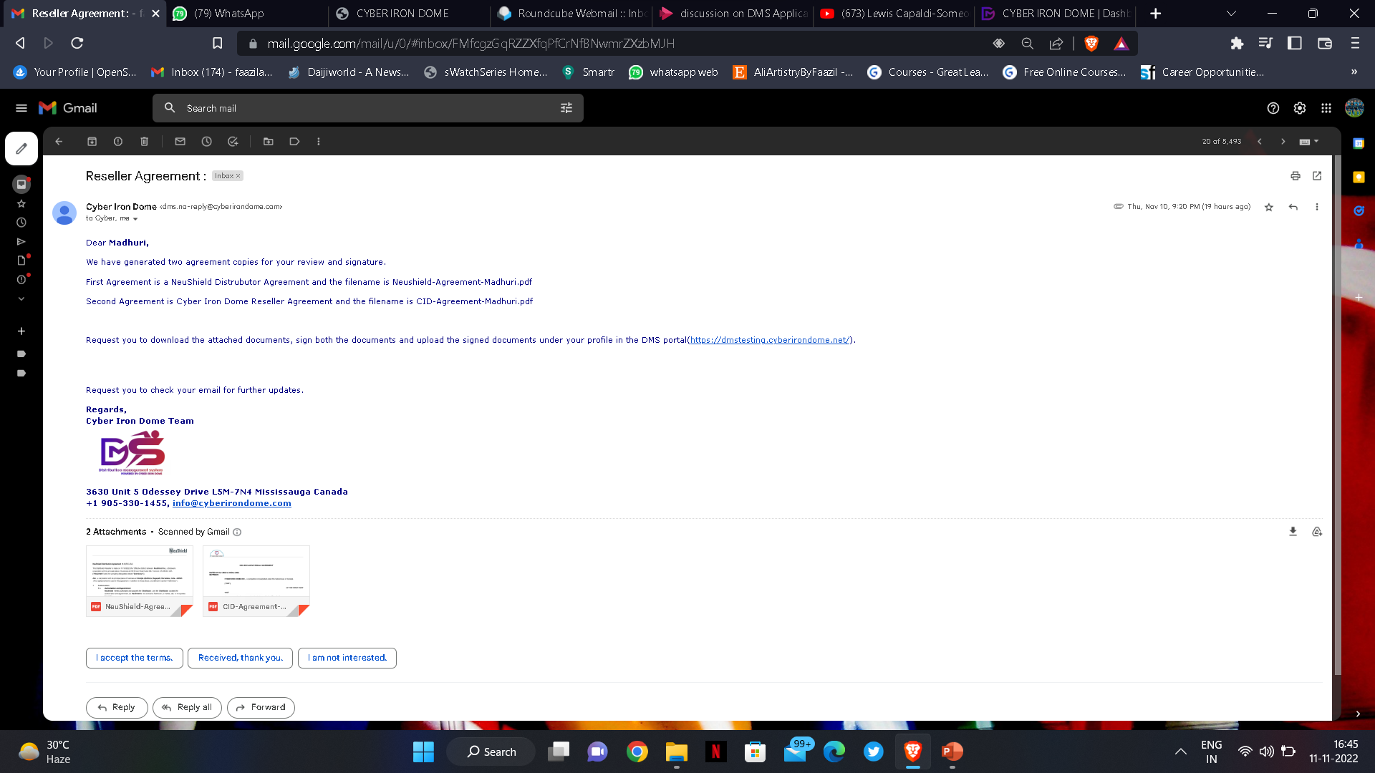
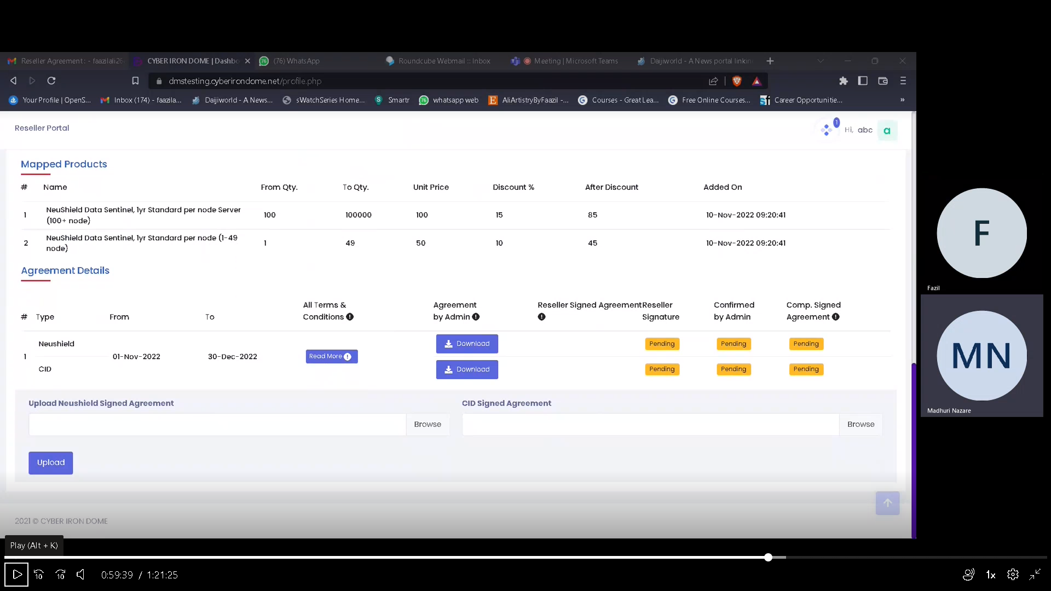
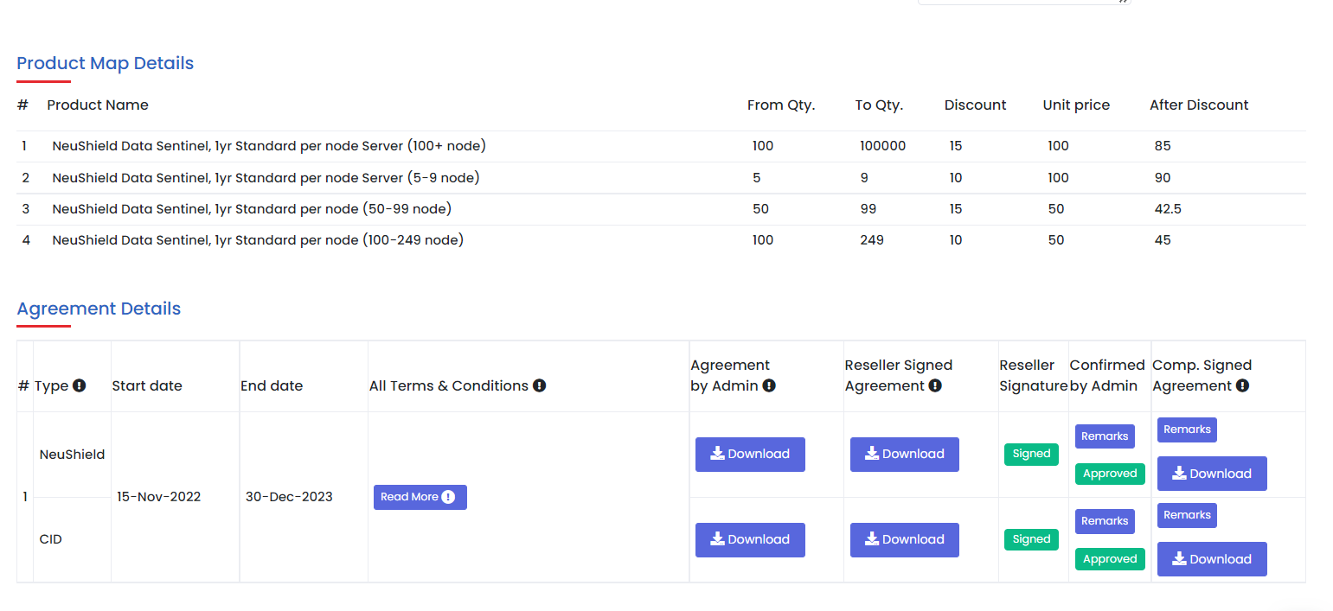

CID and NeuShield agreements which has to be signed by both reseller and admin.
An auto-generated email will be sent to the re-seller where he will receive CID Agreement and NeuShield Agreement.
Once all documents are successfully approved and signed by admin, reseller will be considered as an Active Re-seller.
Page 9 of 20

Slide 10
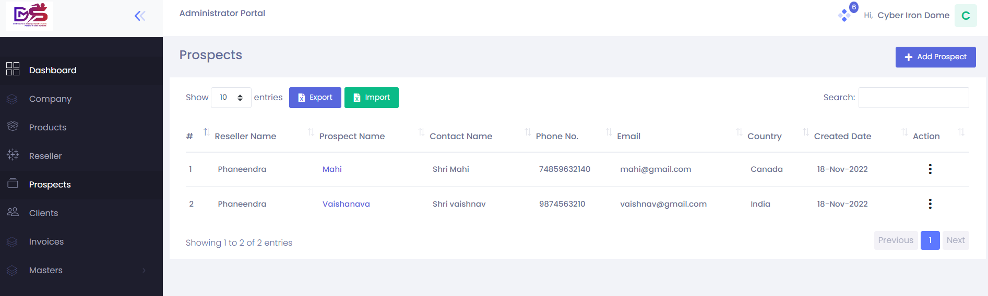
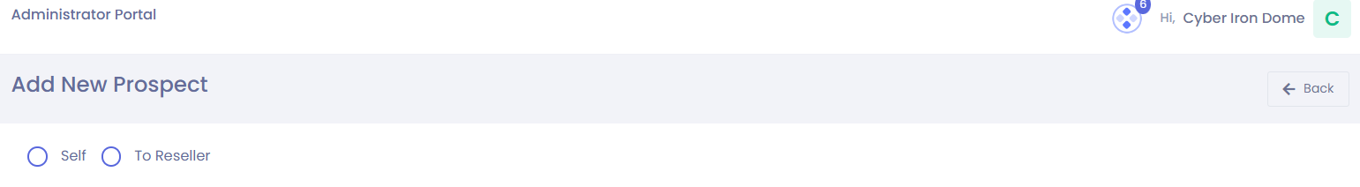
Admin Portal in DMS
All the Prospects details mentioned here where Admin/Reseller can add and manage his prospects.
In DMS Admin and Partners both will have authority to add and manage their prospects.
At Admin portal while adding prospect admin has option to add for self or to Reseller.
Page 10 of 20

Slide 11
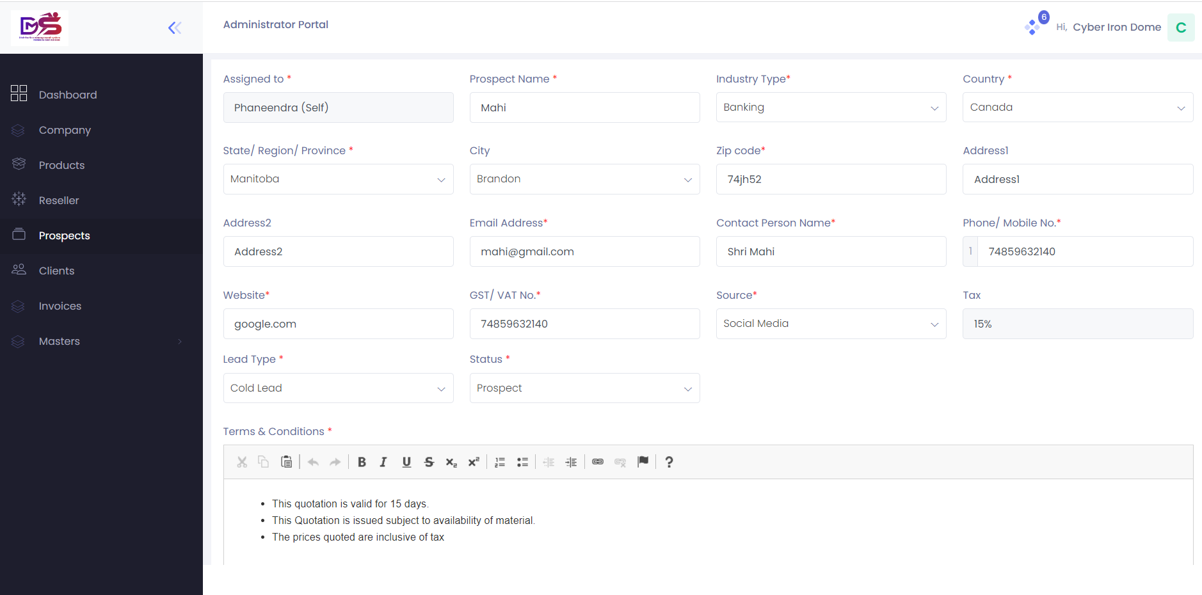
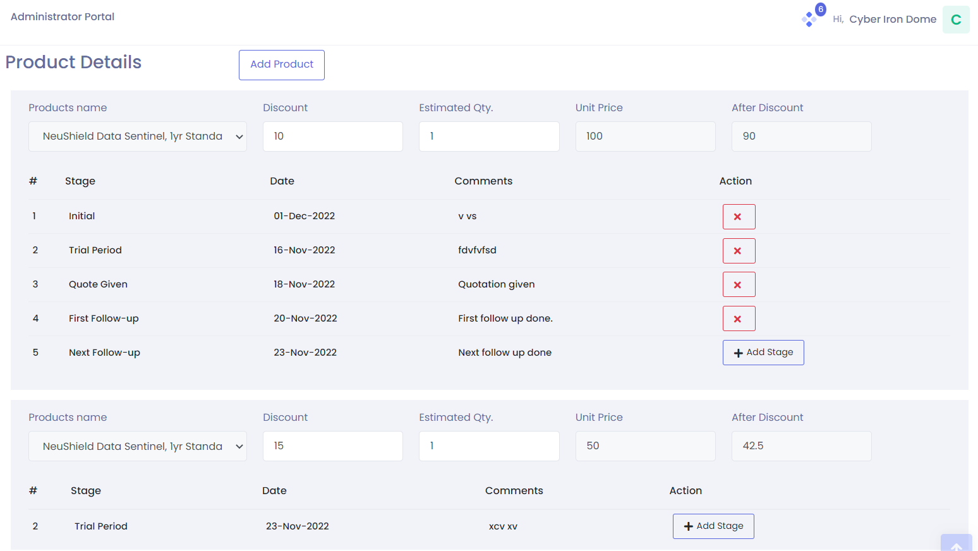
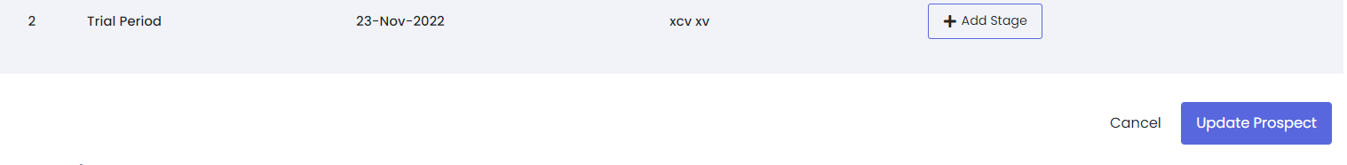
For adding a Prospect admin has to fill in all the demographic details of the prospect.
Along with that all the Terms and Conditions mentioned.
As per discussion Admin will add Product details by clicking on Add product.
Once the products are added using Add stage option admin can update prospect stages as per date & comments.
Admin will add stages as per progress :
Initial stage
Demo
Trial period
Quote Given
First follow-up
Next follow-up
Order won
Page 11 of 20

Slide 12
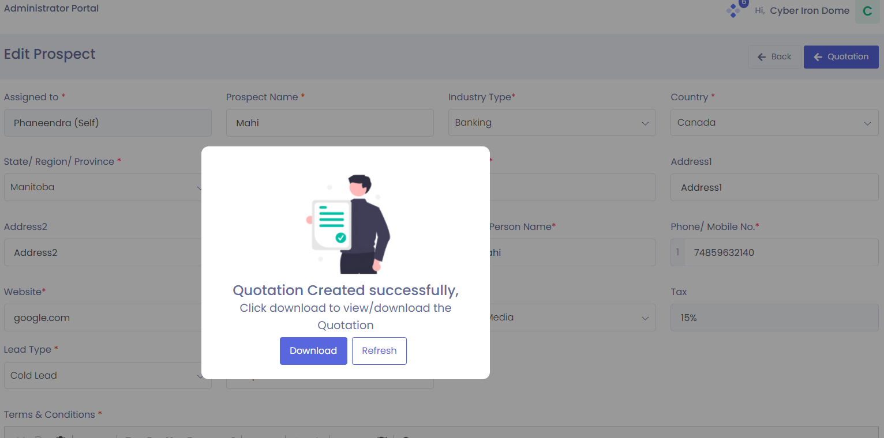
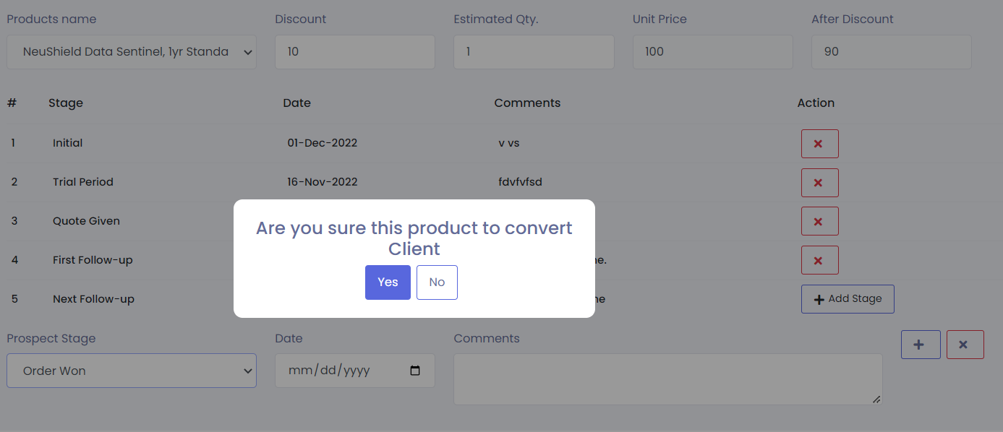
At the Quote given stage Quotation will generated and by clicking on Quotation option Admin can Download the Quotation which will be
auto-generated.
At Order Won Stage Prospect will be converted into client.
And that Prospect will be considered as Client.
Page 12 of 20

Slide 13
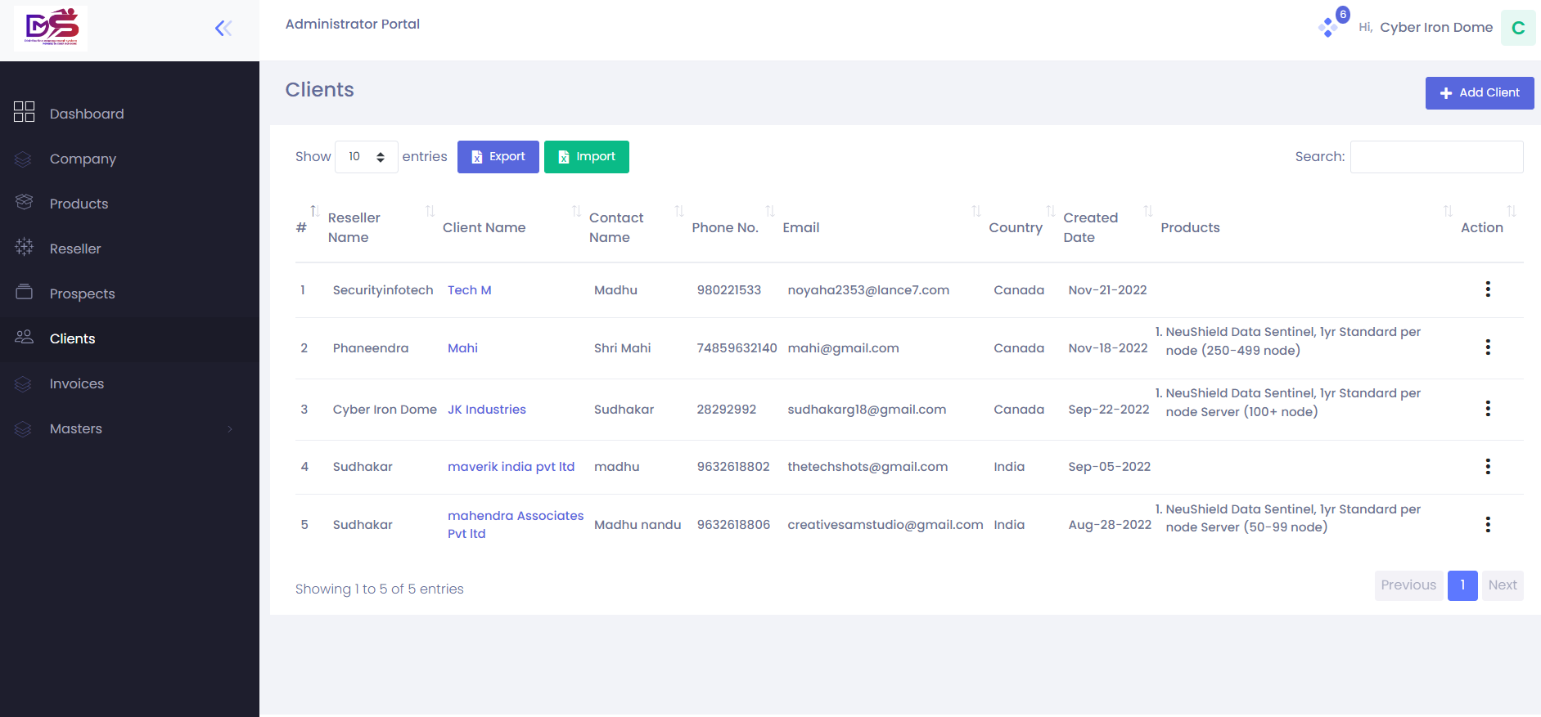

Admin Portal in DMS
All the Clients details mentioned here where Admin/Reseller can add and manage their Clients.
Page 13 of 20

Slide 14
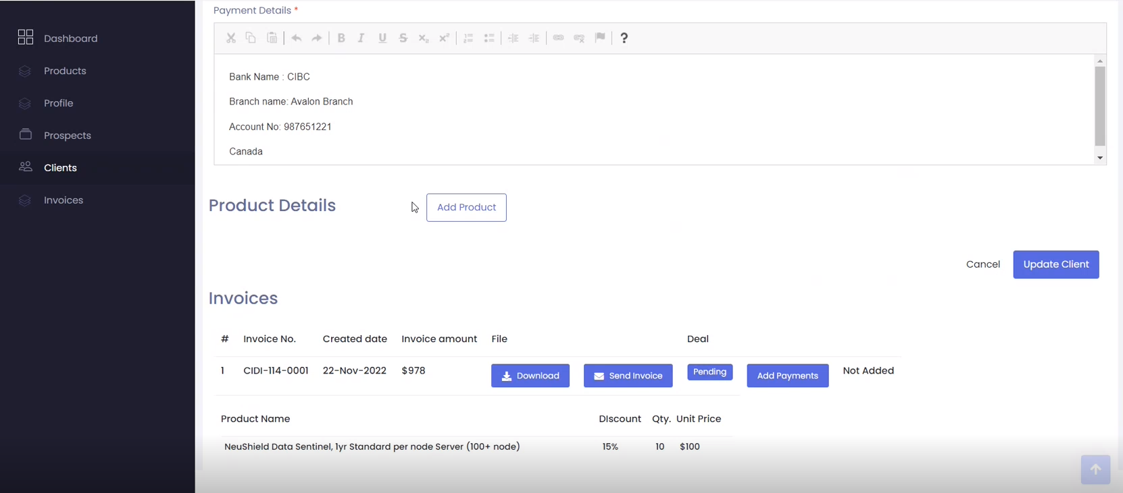
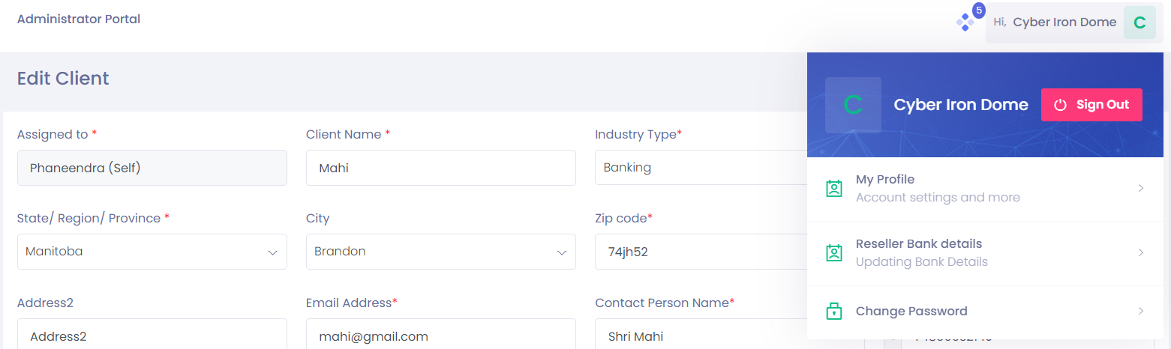
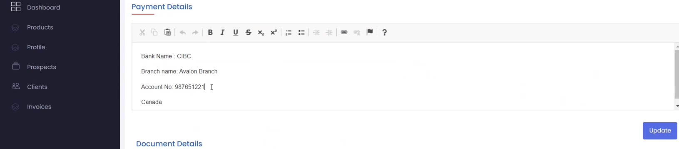
Once Order won for next step of procedure at client portal are Bank Details, which cannot be directly Edited or Changed. So if one has to edit, he needs to visit “My Profile” and then do the required changes from there for both Admin/Reseller bank details. The same Bank details will be available in the Invoice Bill .
Page 14 of 20

Slide 15
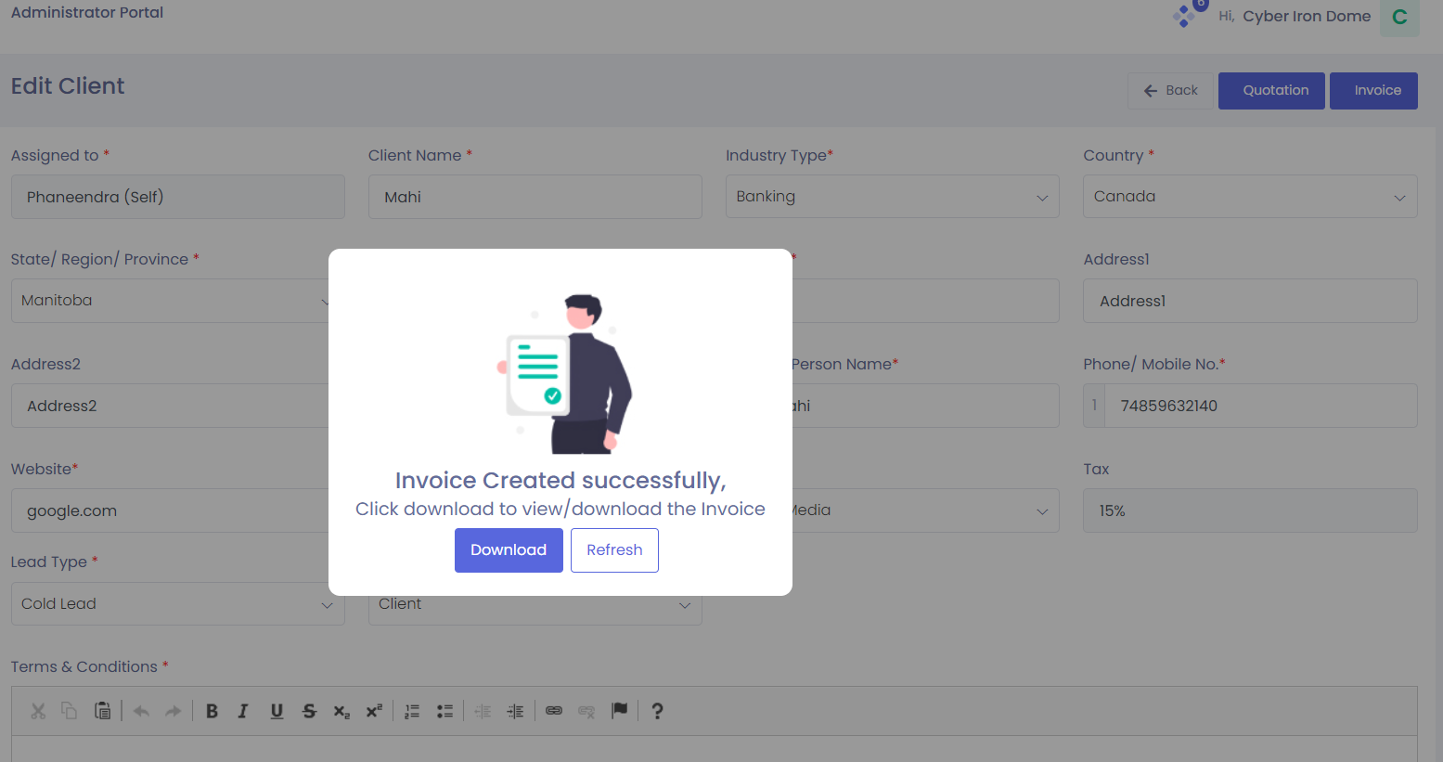
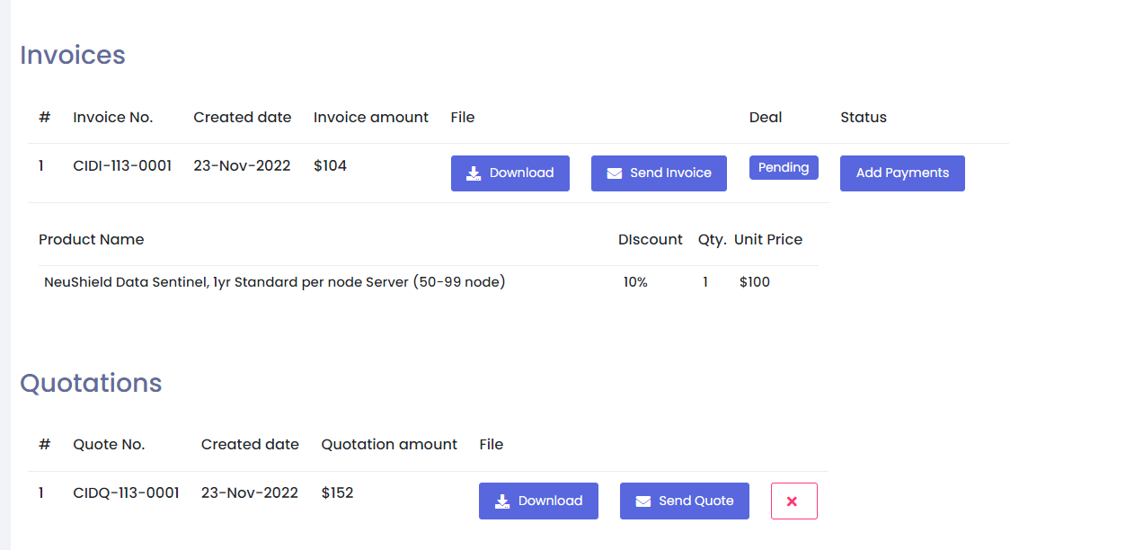
Once Prospect will be converted into Client at order won stage Invoice will be auto-generated along with Bank details mentioned at client portal.
By clicking on Invoice option admin can download the Invoice.
At client portal admin has authority to Download or send Mail of both Quotation/Invoice.
At Add Payments option admin will add the payment details of the client as per agreement.
Page 15 of 20

Slide 16
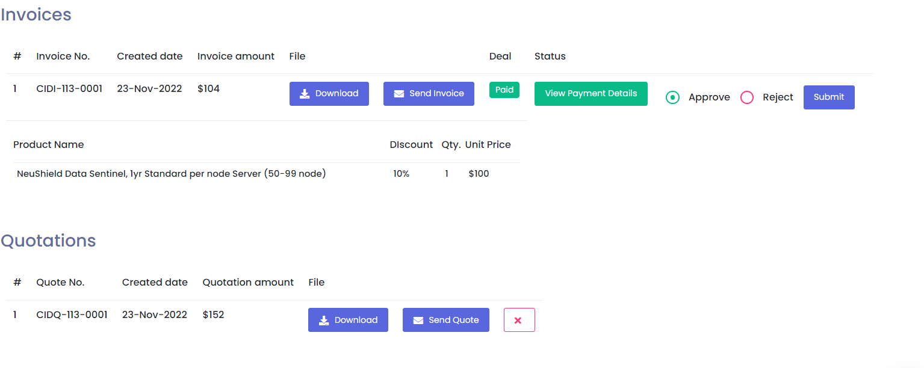
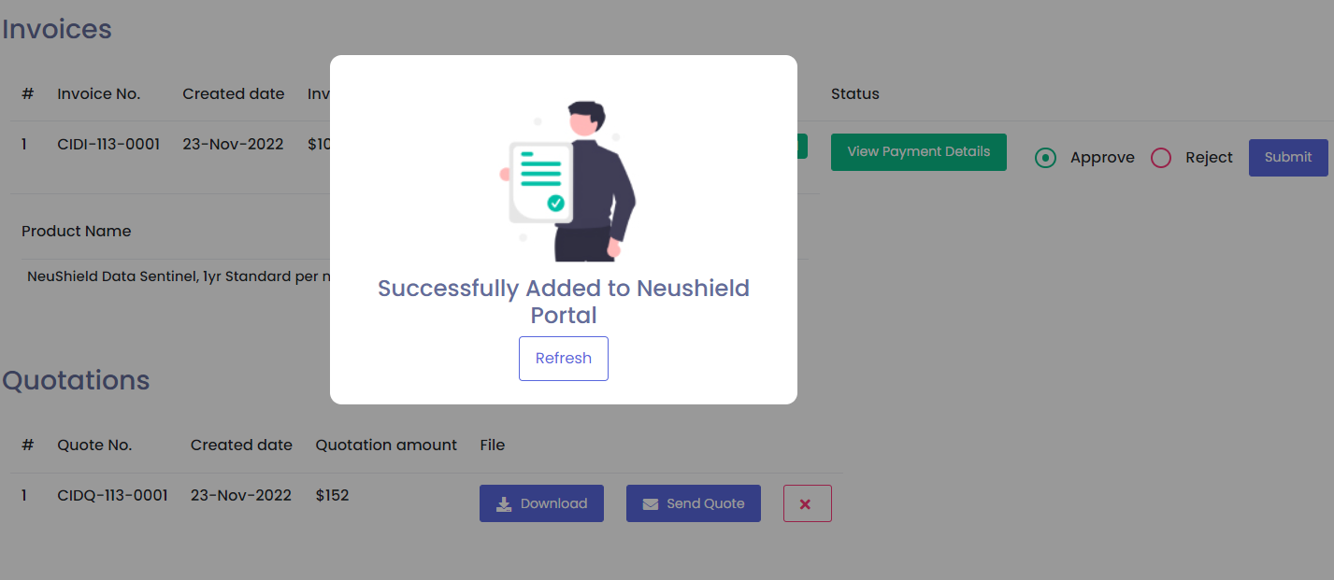
Once the Payment details added successfully admin will have the authority to Approve / Reject the payment details on clicking the Submit button.
Once the payment details will be approved successfully by admin, Invoice will be added to NeuShield portal for generating license.
Page 16 of 20

Slide 17
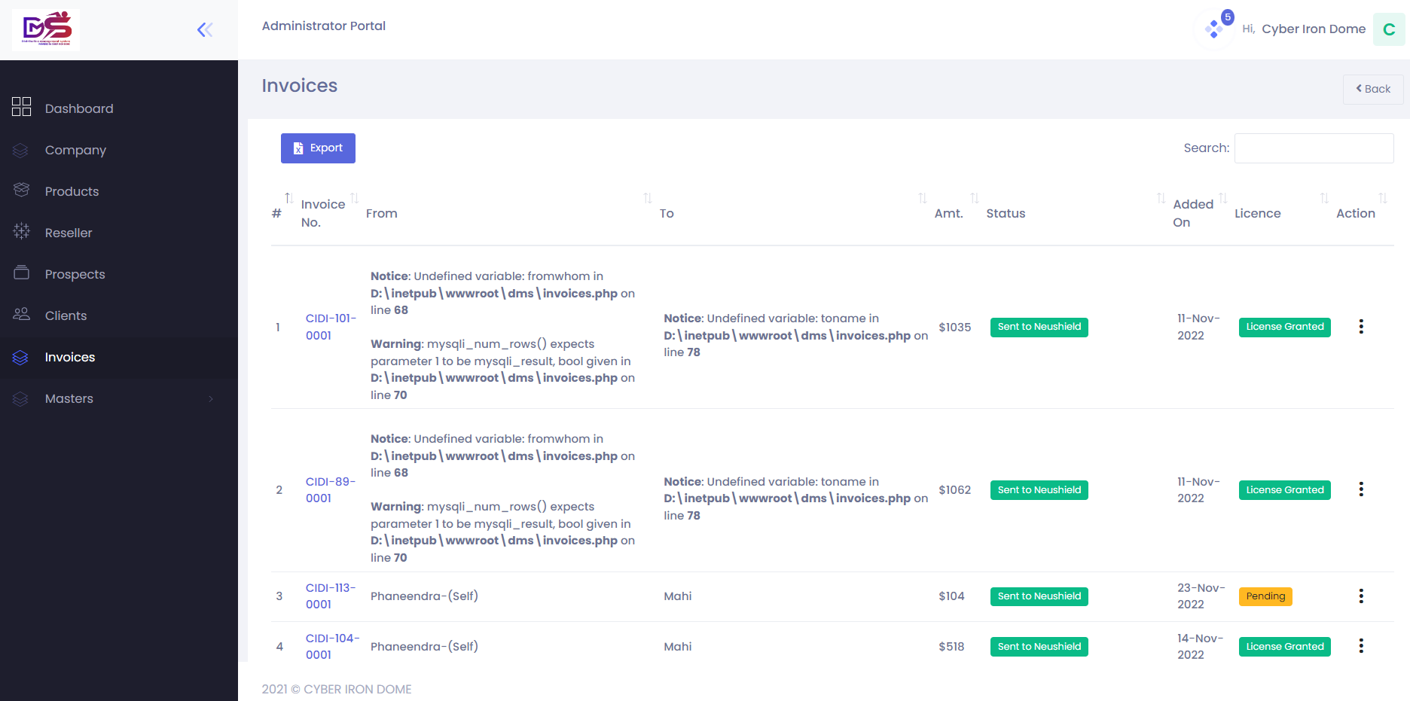
Admin Portal in DMS
All the Invoice details mentioned here where Admin can have the authority to view or export the data.
Page 17 of 20

Slide 18

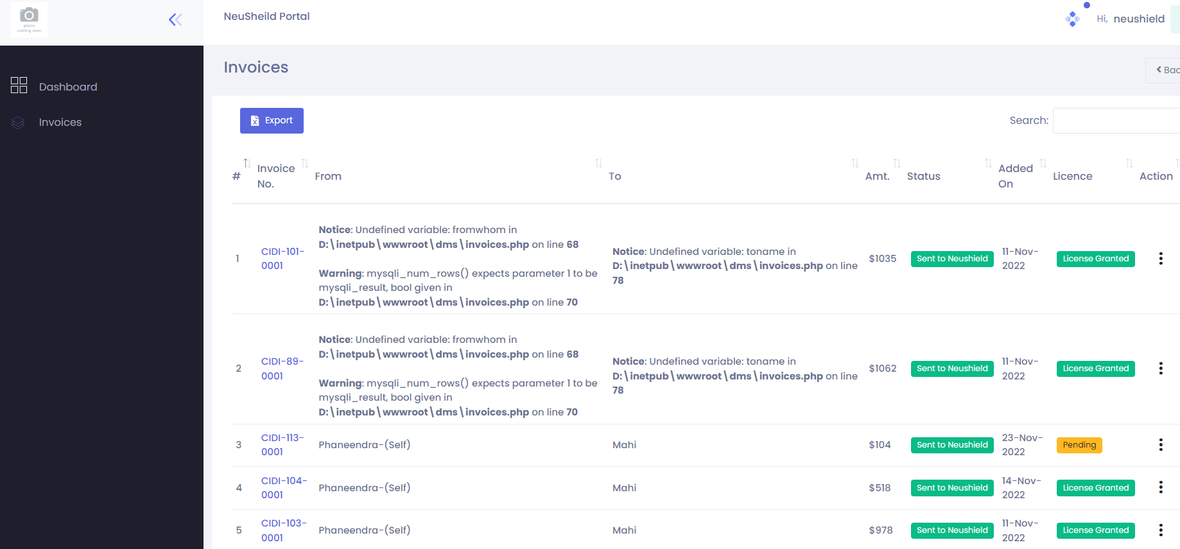
NeuShield Portal in DMS
The Dashboard of the NeuShield Portal where all the details are captured to view.
At NeuShield Portal, NeuShield has the authority only to view the process .
The Invoice of the NeuShield Portal where all the details are captured to view and export the data.
At NeuShield Portal, NeuShield can check the payment details and accordingly has the authority to pass the License for the payment done successfully.
Page 18 of 20

Slide 19
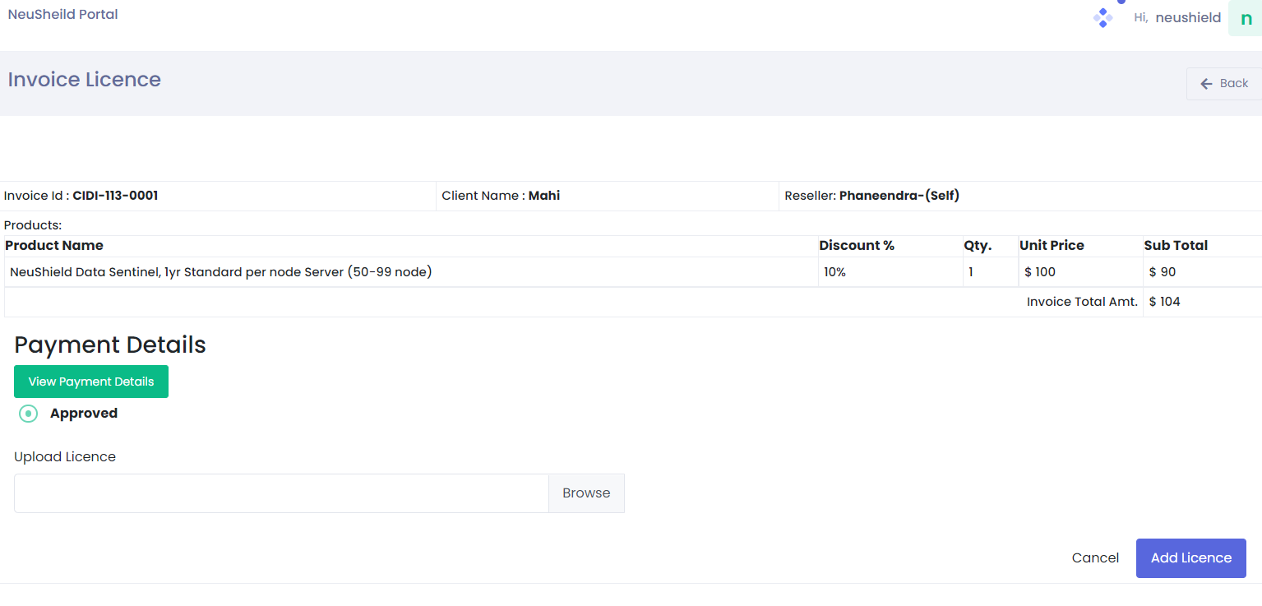
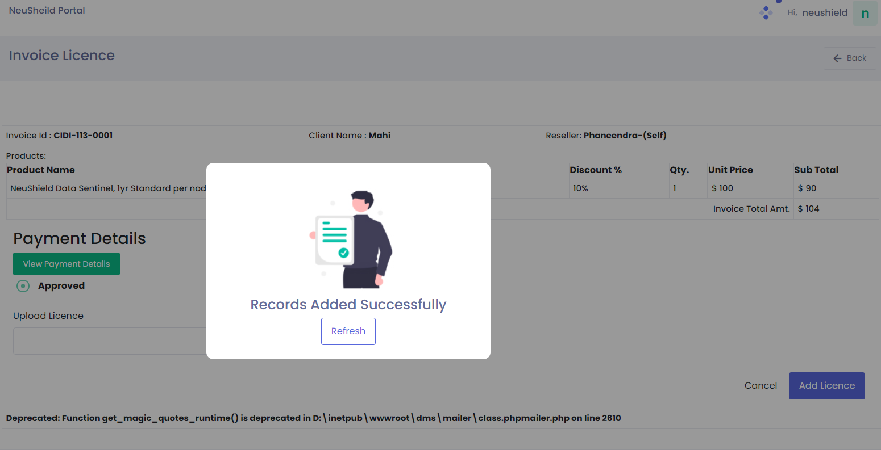
Once Payment Details are successfully approved by the Admin.
At NeuShield Portal, NeuShield will Browse the License key code.
And add the license by clicking on the Add license option.
Finally that particular client’s records will be added successfully.
And this process will continue for each and every Clients.
Accordingly the Dashboards will also be updated time to time of Resellers/Admin/NeuShield.
Page 19 of 20

Slide 20
Thank you

